Slide 1
Benefits and Challenges of Generative AI in Software Development:
A Survey-Based Study
Ilona Pawełoszek
Czestochowa University of Technology,
Poland
Notes:
Good evening, everyone. It’s a pleasure to be here.
I’m Ilona from Poland, and I’d like to share my recent work on the benefits and challenges of Generative AI in software development, based on survey results.

Slide 2
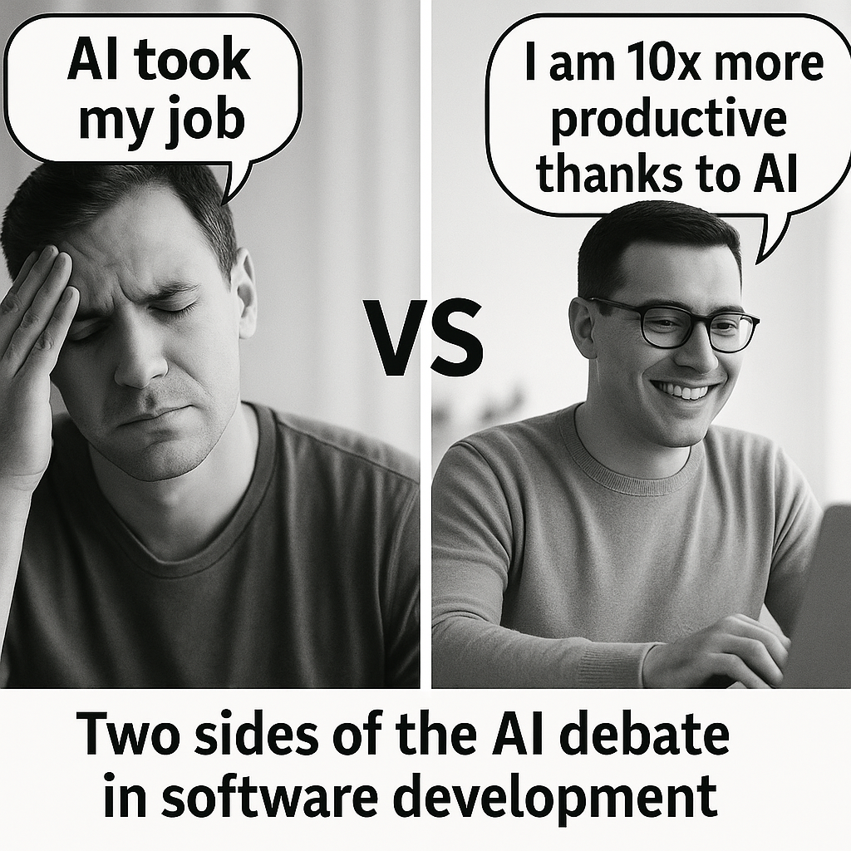
Context & Motivation
Generative AI tools (GitHub Copilot, Tabnine, Codex) are reshaping coding practices.
Potential: up to 45% cost reduction, 30–50% productivity gains (McKinsey).
Research gaps:
Organisational context and developer roles.
Stages beyond implementation (e.g., planning, design).
Notes:
In recent years, many AI tools have emerged to support programmers — from general-purpose models to specialised fine-tuned solutions.
According to consulting firm reports, Generative AI can reduce costs and improve productivity by as much as 50 percent.
However, such sensational claims also raise many doubts in the public debate. Jensen Huang, the CEO of NVIDIA, even said that soon ‘software will write software’.
This leads to a key question: what is the organisational and social context of using Generative AI in programming?

Slide 3
Research questions
RQ1 – Relationship between developer profiles and perceived usefulness.
RQ2 – Which aspects of work are most supported by GenAI.
RQ3 – Job insecurity and productivity expectations linked to GenAI adoption.
RQ4 – Role of organisational support.
RQ5 – Commonly reported challenges.
Notes:
In my study, I focused on five main research questions.
First, I asked whether there is a relationship between developer profiles and their perceptions of the usefulness of Generative AI.
Second, I wanted to identify which aspects of programmers’ work are most strongly supported by these tools.
Third, I examined whether the adoption of Generative AI is linked to job insecurity.
Fourth, I explored the role of organisational support in shaping developers’ attitudes.
Finally, I looked at the most commonly reported challenges in using Generative AI.

Slide 4
Methodology
Online survey (Polish/English), Jan–Mar 2025.
N = 62 software professionals.
Mixed methods:
  Quantitative — descriptive stats, Kruskal–Wallis + Dunn tests.
  Qualitative — thematic analysis of open-ended responses.
Notes:
To answer these questions, I conducted an online survey in both Polish and English between January and March 2025.
I shared the questionnaire through professional contacts and social media, and in many cases I reached out individually.
It was not easy, because software professionals are very busy, but in the end I collected responses from 62 people.
I used a mixed-methods approach.
On the quantitative side, I applied descriptive statistics as well as Kruskal–Wallis and Dunn tests.
On the qualitative side, I carried out a thematic analysis of the open-ended responses.

Slide 5
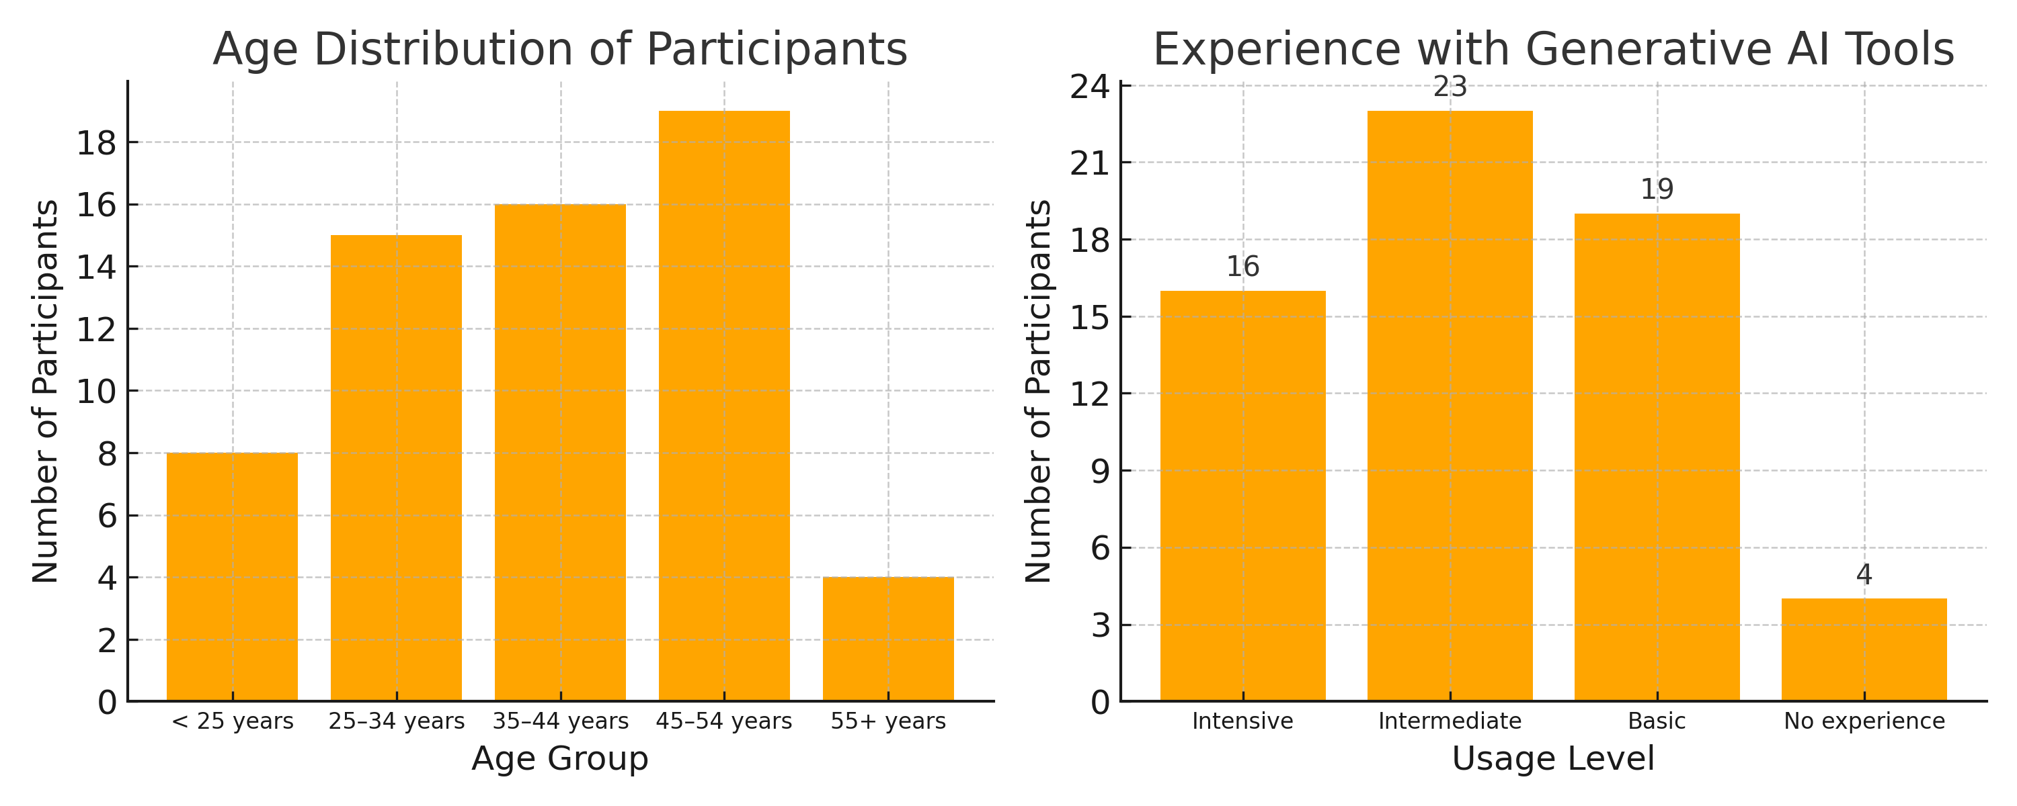
Respondent Profile
Largest age group: 45–54 years.
GenAI use: 16 advanced, 23 intermediate, 19 basic, 4 non-users.
Majority: senior/lead developers.
Notes:
Now let me briefly describe the profile of my respondents.
The largest age group was between 45 and 54 years old.
In terms of Generative AI usage, there was a good spread: 16 advanced users, 23 intermediate, 19 basic users, and 4 non-users.
Most respondents were senior or lead developers, which means they brought extensive professional experience to the survey.
So overall, while the sample was relatively small, it reflected a variety of perspectives and levels of expertise.

Slide 6
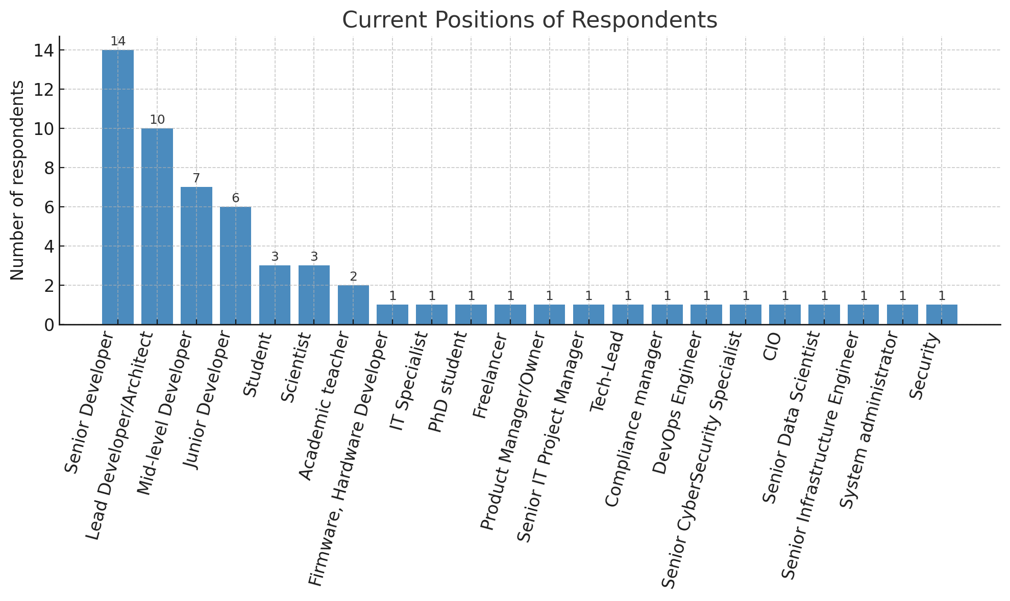
Current Positions of Respondents
Wide variety of roles — from senior developers to academic teachers, scientists, and freelancers.
Largest groups:
  Senior Developers (14)
  Lead Developers/Architects (10)
  Mid-level Developers (7)
  Junior Developers (6)
High fragmentation prevented statistical analysis by role.
Notes:
Here you can see the current positions of my respondents.
They represented a wide variety of roles — from senior developers and software architects, to academic teachers, scientists, and freelancers.
The largest groups were senior developers, with 14 participants, and lead developers or architects, with 10 participants.
There were also mid-level and junior developers, but the overall distribution was highly fragmented.
Because of this diversity, it was not possible to conduct a meaningful statistical analysis by job role.
Still, the chart illustrates well the broad spectrum of professional backgrounds represented in the survey.

Slide 7
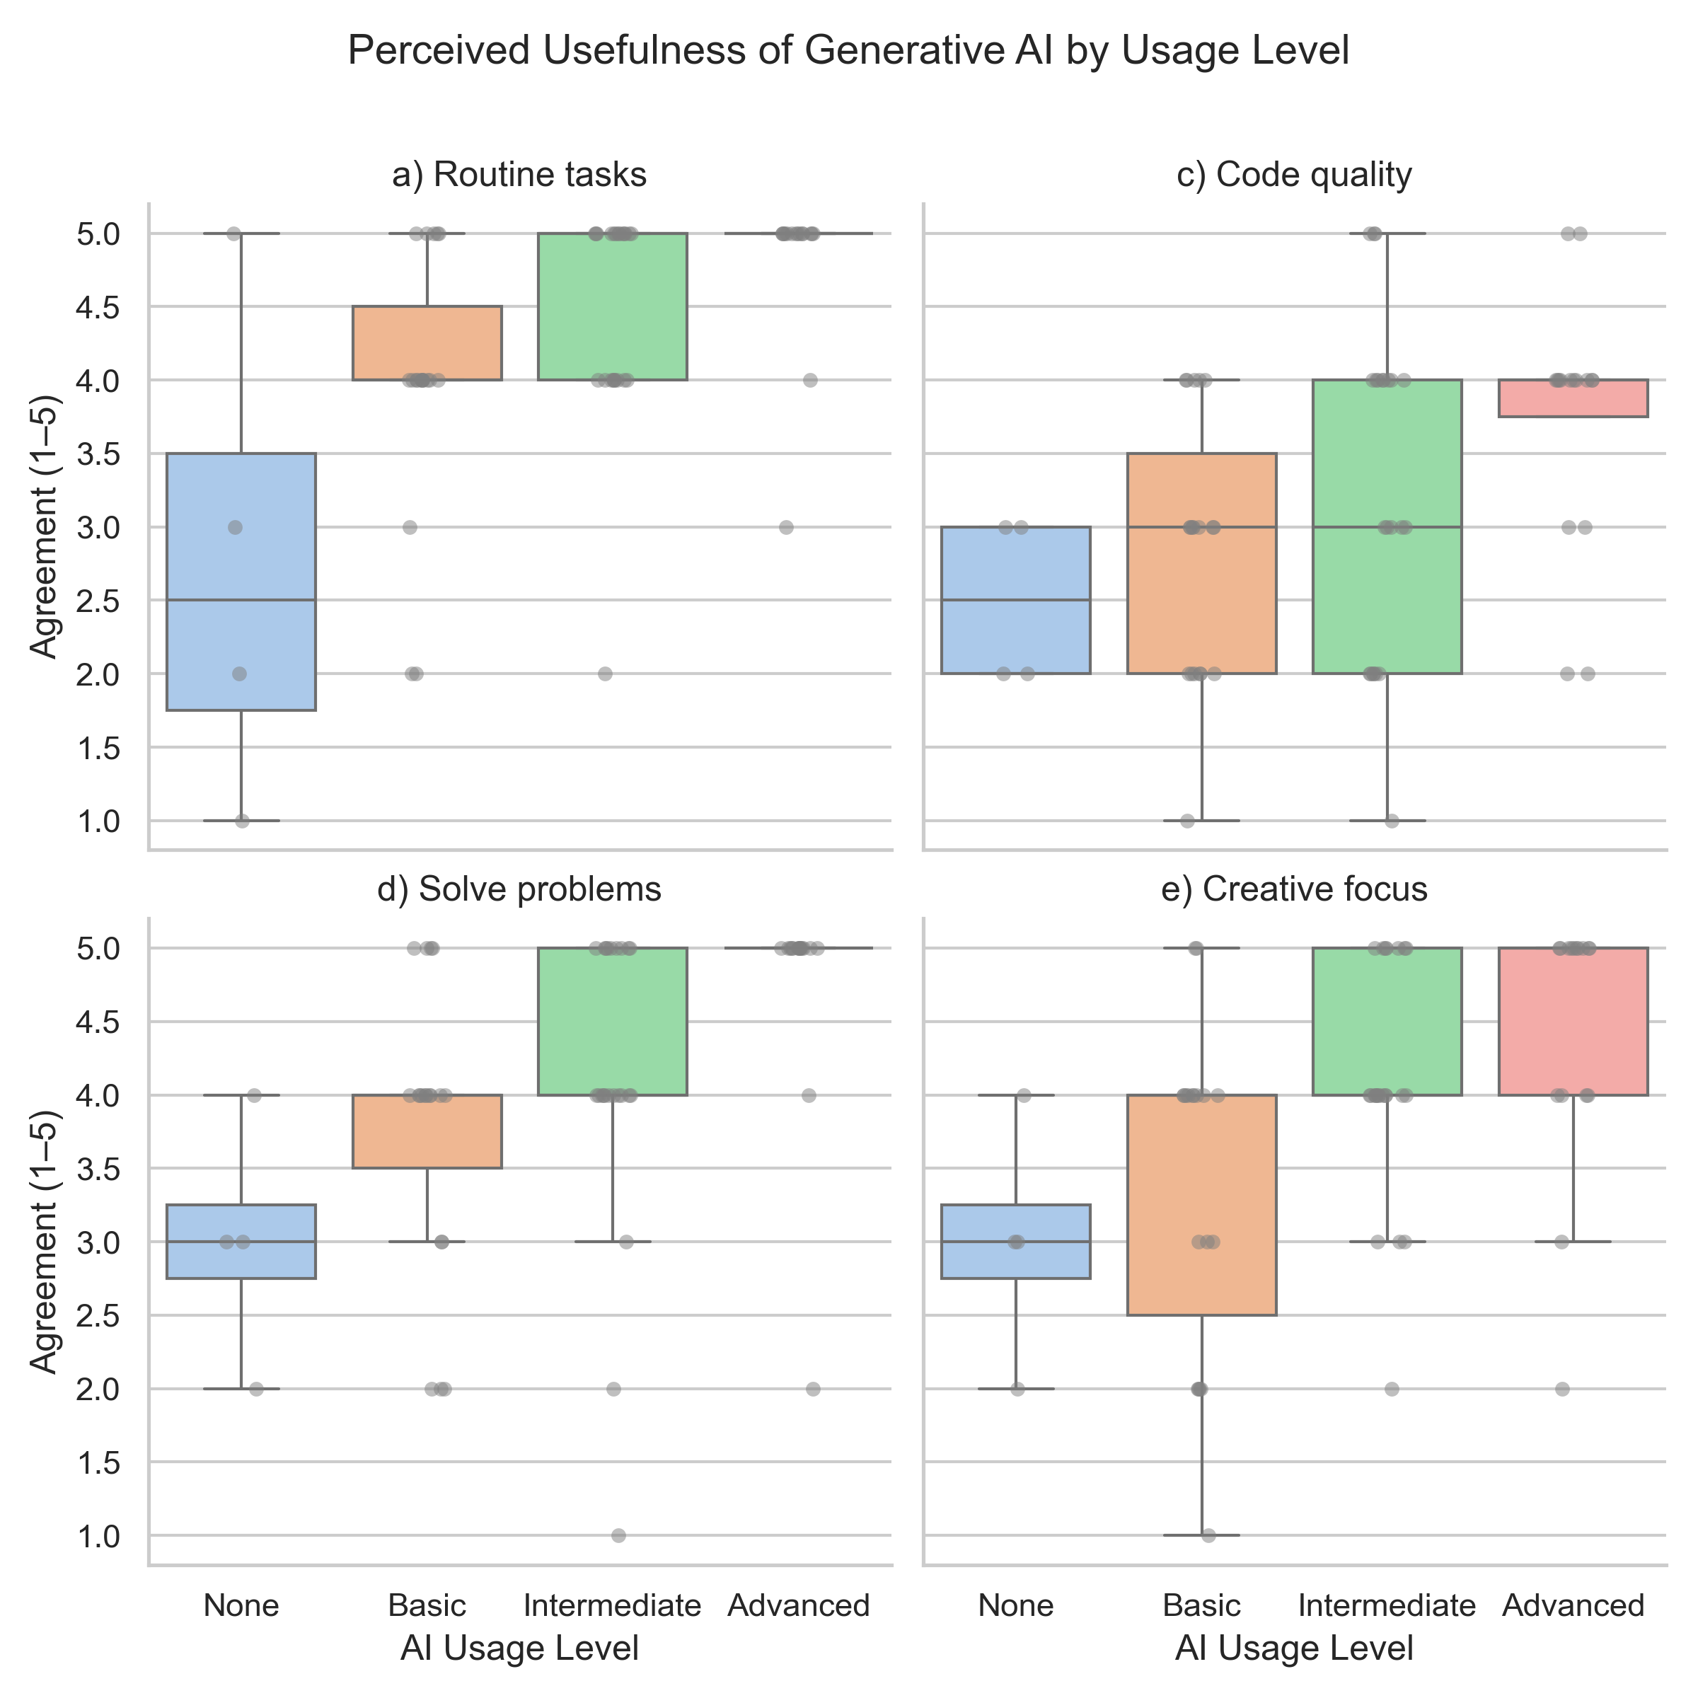
RQ1: Perceived Usefulness by AI Usage Level (Part 1)
Dimensions with significant differences:
- Routine tasks
- Solve technical problems
Clear upward trend from non-users → advanced users.
Notes:
Let me start with the first research question: the relationship between developer profiles and the perceived usefulness of Generative AI.
Here we can see two dimensions where the differences were statistically significant: support with routine tasks and solving technical problems.
The results show a clear upward trend — from non-users to advanced users.
In other words, the more experience respondents had with AI tools, the more useful they found them, especially for everyday coding and troubleshooting.

Slide 8
RQ1: Perceived Usefulness by AI Usage Level (Part 2)
Dimensions with more variation:
- Code quality
- Creative focus
Advanced users still rate higher, but variation is greater.
Notes:
On the second part of this slide, we look at two additional dimensions: code quality and creative focus.
Here the variation is greater, but the general trend is still visible.
Advanced users again rated Generative AI more positively, though their opinions were not as uniform as in the previous case.
This suggests that while AI tools are widely appreciated for routine and technical support, their impact on creativity and code quality is perceived in more diverse ways.
If we compare these two aspects, we can see that creative focus is generally rated higher than code quality.
Advanced users in particular felt that AI tools helped them to stay more creative, while opinions on code quality were more mixed.
This shows that developers may trust AI to free their minds for higher-level thinking, but they are more cautious when it comes to relying on AI for producing high-quality code.

Slide 9
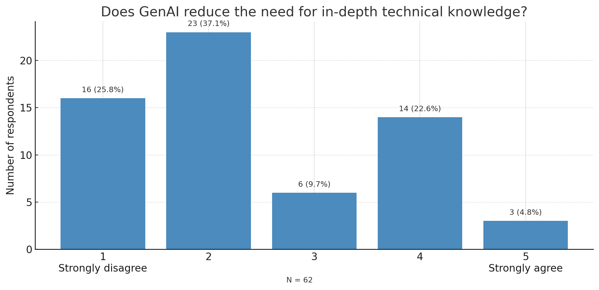
Does GenAI reduce the need for in-depth technical knowledge?
Opinions are divided — GenAI complements, but does not fully replace, in-depth technical knowledge.👉
Notes:
Here, we did not find any statistically significant differences between groups by experience or GenAI usage.
But if we look at the overall distribution, the picture is still interesting. Almost two thirds of developers disagree that generative AI reduces the need for in-depth technical knowledge, while a smaller group believes it does to some extent. Only a handful strongly agree.
So there is no clear consensus. Generative AI is seen more as a complement to technical expertise, rather than a replacement.

Slide 10
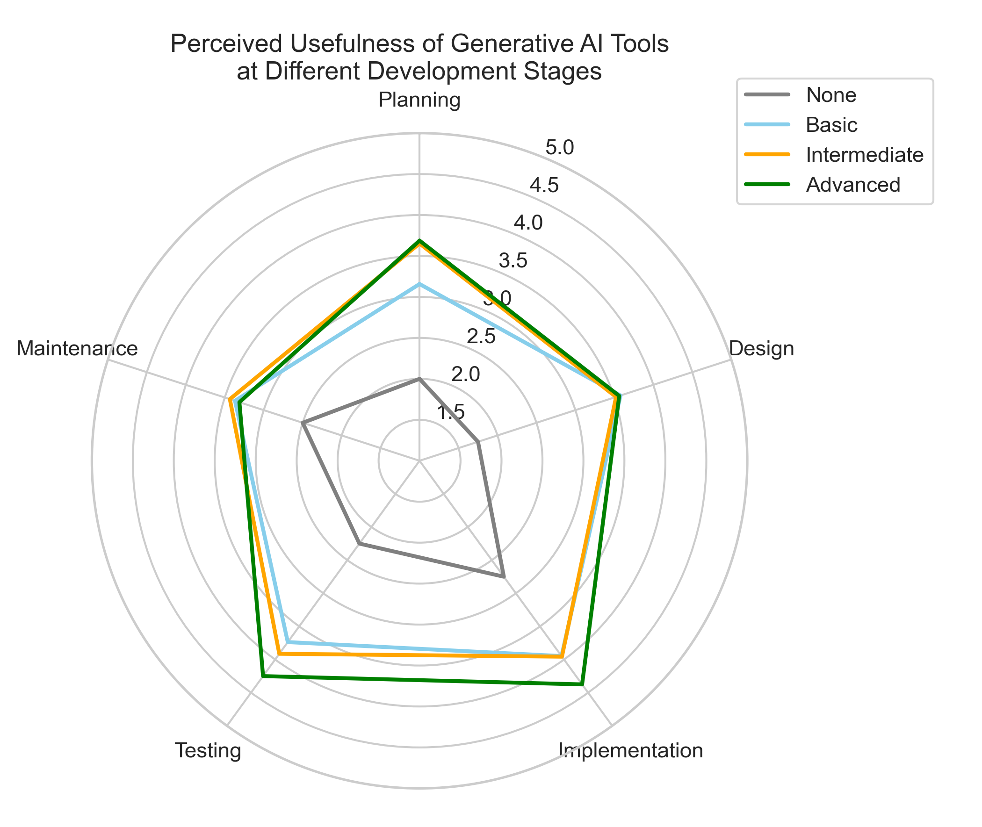
RQ2: Usefulness Across
Development Stages
Highest usefulness: Implementation, Testing.
Lowest: Planning, Maintenance.
Advanced users more positive across all stages.
Notes:
Now let’s move to the second research question: at which stages of the software development process do programmers find Generative AI most useful?
The results show the highest usefulness during the implementation and testing phases.
This is not surprising, because these stages involve a lot of coding and debugging, where AI can directly suggest solutions and generate code snippets.
On the other hand, the lowest usefulness was reported in planning and maintenance.
This suggests that Generative AI tools are still perceived mainly as coding assistants rather than strategic or long-term support systems.
Another important observation is that advanced users were consistently more positive across all stages.
This indicates that experience with the tools increases confidence in applying them more broadly, even beyond the purely technical phases.

Slide 11
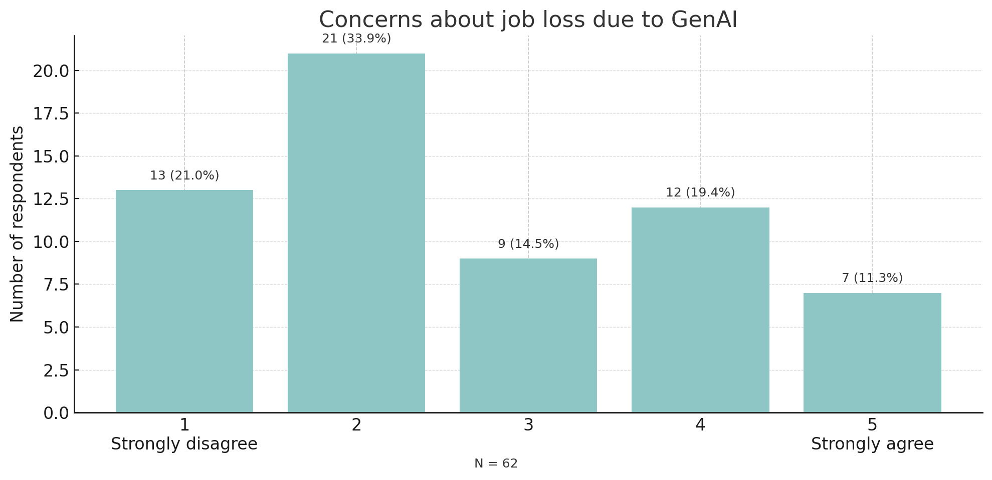
RQ3: Job Loss Concerns
Most developers do not fear losing their jobs due to GenAI, but nearly one third express some level of concern.
Notes:
The next research question I asked was about job loss concerns. Do developers feel that generative AI could eventually make them redundant in the job market?
Looking at the overall results, we see that most respondents do not share this fear — more than half disagreed with the statement. At the same time, almost one third expressed some level of concern, either agreeing or strongly agreeing.
So while the majority are relatively confident about their future, there is still a substantial minority of developers who feel uncertainty about the long-term impact of generative AI on their jobs.

Slide 12
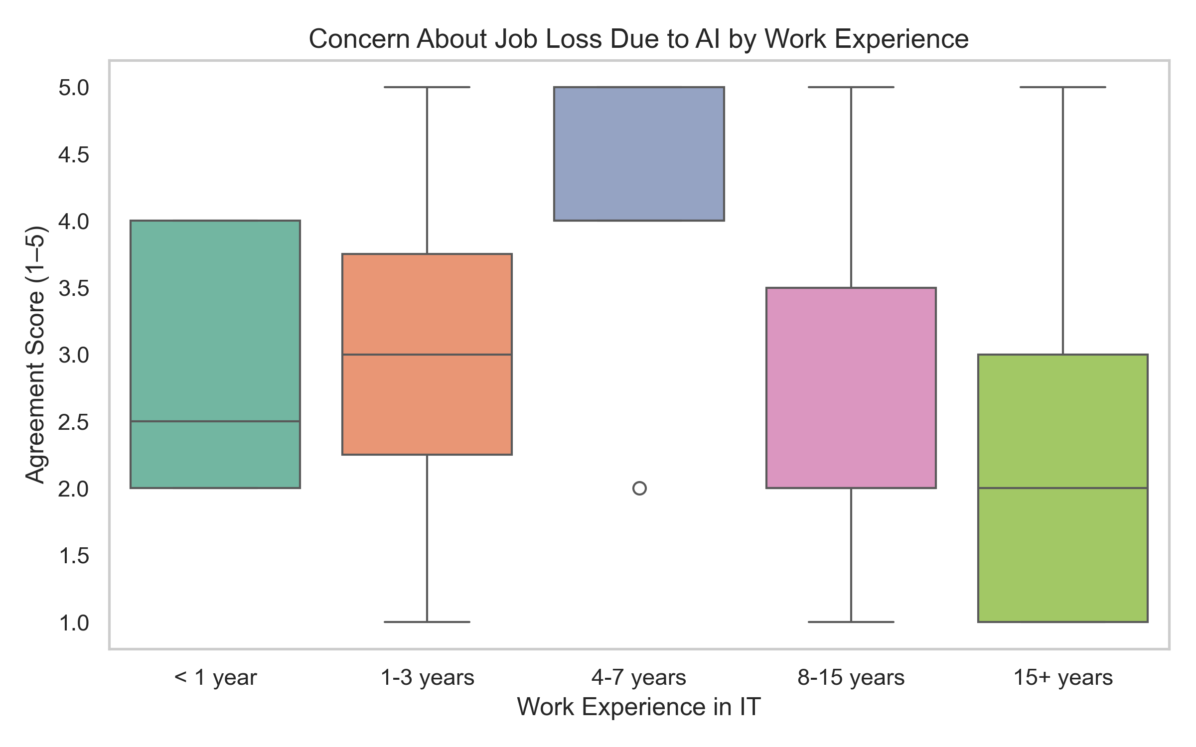
RQ3: Job Loss Concerns
Less experienced developers (<3 years) show the highest fear of job loss due to GenAI.
Experienced professionals are less worried, likely due to familiarity with tech changes.
Notes:
This chart shows the concern about job loss due to AI, broken down by work experience.
Interestingly, the group with 4 to 7 years of experience expressed the strongest fear, with scores close to 4 on average.
Early-career professionals were also worried, although their responses were more mixed.
By contrast, the most experienced developers — with over 8 years in the industry — reported the lowest concern.
This suggests that senior professionals see AI as just another wave of technological change, while those still building their careers may feel more vulnerable.

Slide 13
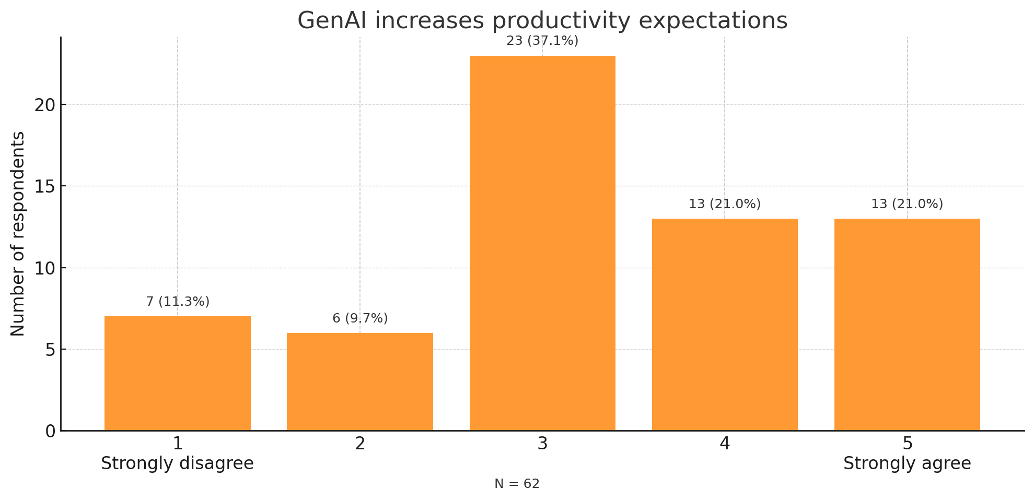
RQ3: Productivity Expectations
Notes:
The next question I asked was about productivity expectations. Do programmers feel more pressure to deliver tasks faster when they use generative AI?
Before looking at specific groups, let’s start with the overall picture. Here we can see that opinions are mixed. Around 40 percent of respondents agreed or strongly agreed that AI raises productivity expectations, while another 40 percent remained neutral. Only about 20 percent disagreed.
So the overall perception is not unanimous, but it shows a clear tendency: many developers feel that while AI supports their coding, it also comes with higher expectations for faster delivery.

Slide 14
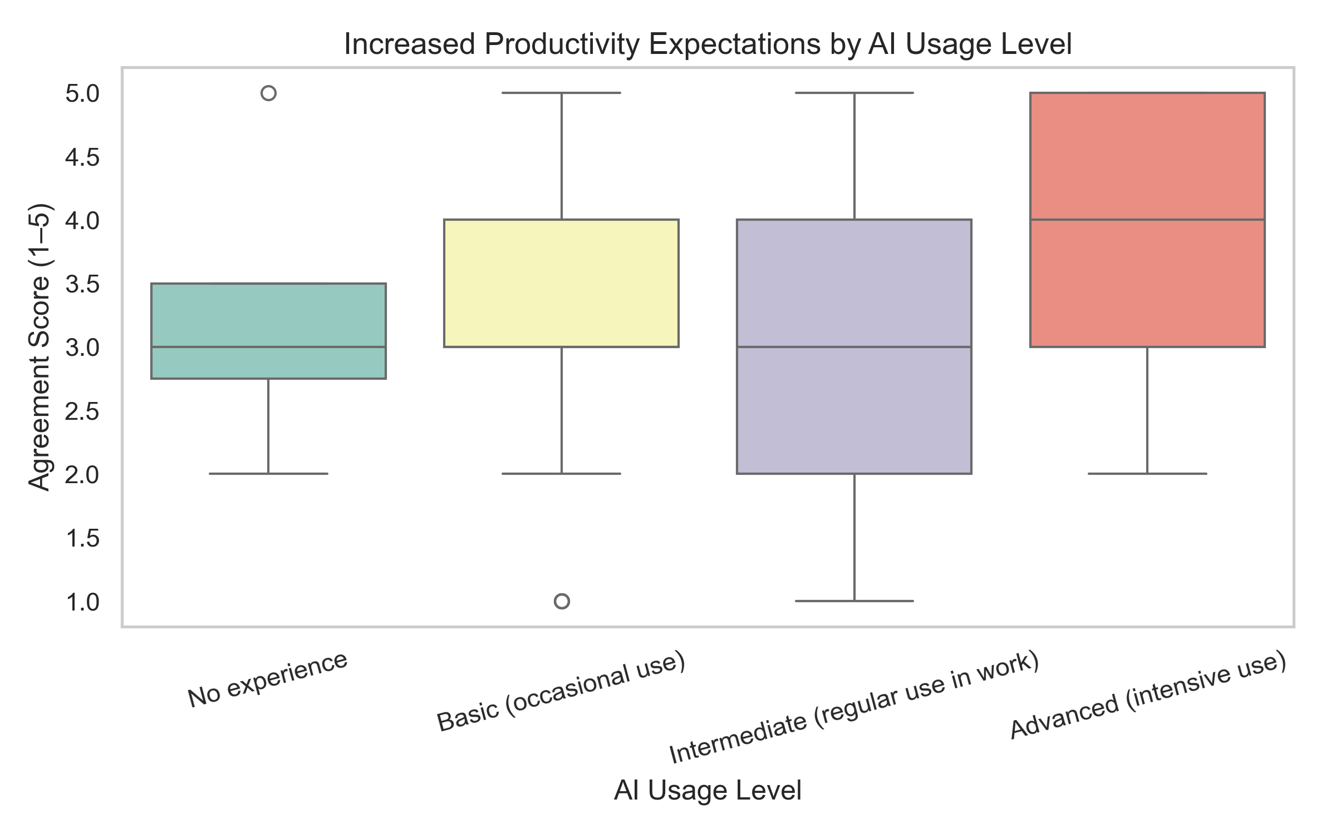
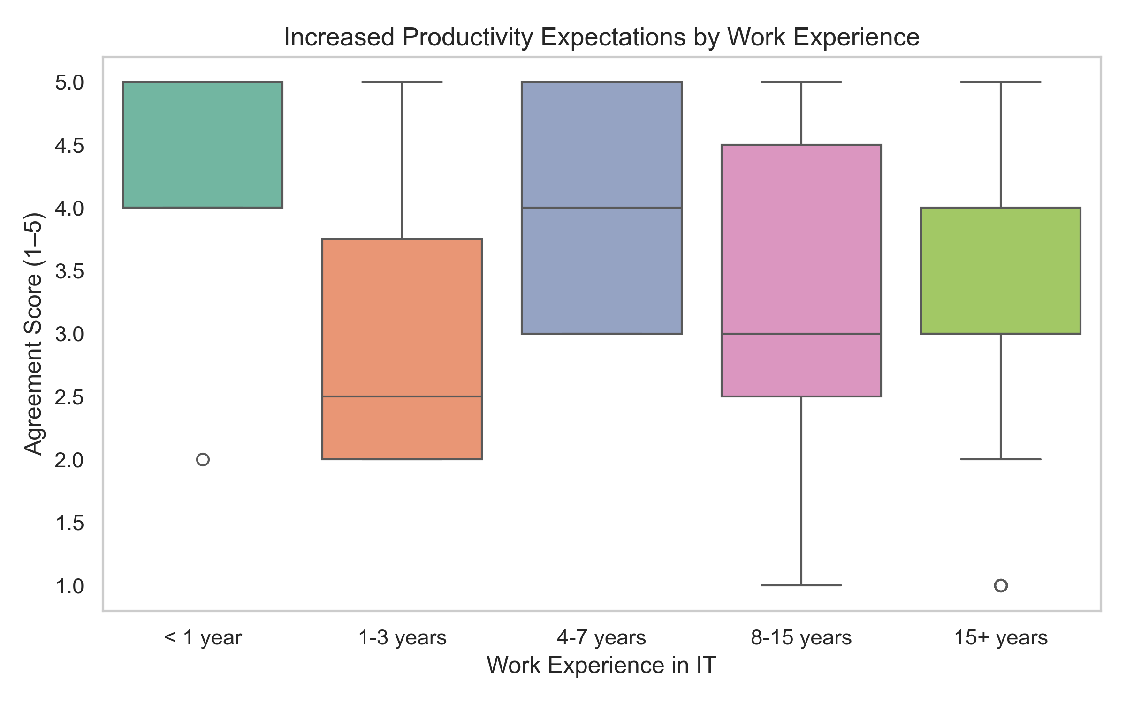
RQ3: Productivity Expectations
Higher pressure to deliver tasks faster reported by:
  Heavy AI tool users.
  Early-career professionals.
Suggests GenAI adoption may disproportionately affect junior staff.
Notes:
As we just saw, the overall picture is quite clear: most programmers feel that Generative AI increases the pressure to be more productive.
But the next question is: who feels this pressure the most?
On the left chart, we can see the results by AI usage level.
Here, advanced users — those who use AI intensively in their work — report the highest productivity expectations.
This suggests that the more you rely on AI, the more others expect you to deliver faster.
On the right chart, we see the same question broken down by work experience.
The strongest pressure is felt by early-career professionals, especially those with less than one year of experience.
For them, productivity expectations are consistently at the top of the scale.
So, taken together, these results show a paradox: the very groups that could benefit most from AI support — juniors and heavy users — are also those under the greatest pressure.

Slide 15
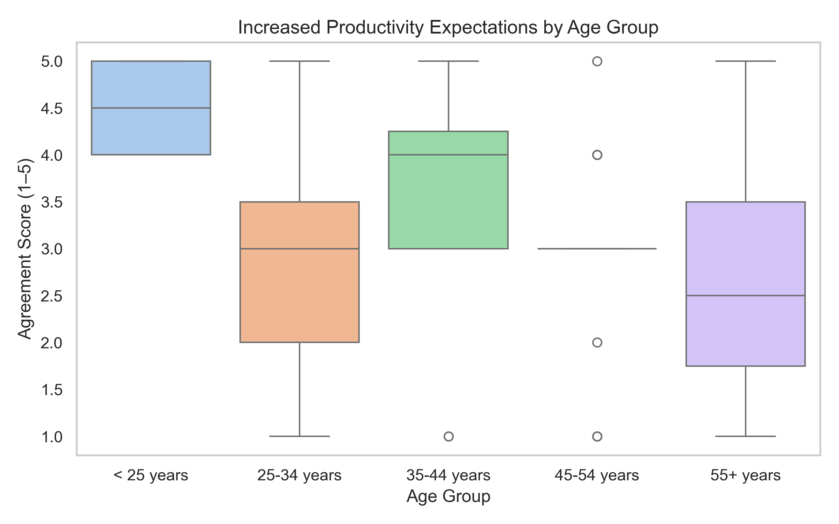
RQ3: Productivity Expectations by Age Group
👶 <25 years → highest productivity expectations (median = 4.5).
👨 25–44 years → mixed results, generally higher than older groups.
👴 45+ years → lowest perceived pressure.
➡️ Perceived productivity pressure decreases with age.
Notes:
As you can see on this slide, the perception of productivity pressure clearly differs by age group.
The youngest developers, those under 25, report the strongest sense of increased expectations — their median score is 4.5, which means that most of them agree or strongly agree that generative AI raises the pressure to work faster.
Developers in the 25 to 44 age range also experience elevated pressure, though their responses are more varied.
By contrast, older developers — 45 and above — tend to feel significantly less pressure. This suggests that experience and seniority may provide a buffer against the sense of being pushed to deliver more simply because AI tools are available.
So overall, the data indicate that perceived productivity pressure decreases with age.

Slide 16


RQ4: Organisational Support
Company stance on AI use does not significantly affect:
Fear of job loss → H = 1.64, p = 0.4415 → not significant
Productivity expectations → H = 3.93, p = 0.1399 → not significant
👉 Perceptions are shaped more by user experience
and seniority than by company policy.
Notes:
For the fourth research question, I examined the role of organisational support.
Specifically, I asked whether the company’s stance on AI use makes a difference.
As the results show, there were no significant effects.
Fear of job loss was not related to company policy, and neither were productivity expectations.
This means that perceptions are shaped much more by personal experience with AI tools and by seniority, rather than by formal rules set by the organisation.
In other words, it doesn’t really matter what the company says about AI — what matters is how developers actually use these tools in their daily work.

Slide 17
RQ5 – Developer Perspectives
✅Benefits
⏱️ Time-saving & efficiency
🛠️ Problem-solving assistance
📘 Learning support
🎨 Creative enablement
⚠️Challenges
❌ Hallucinations & low code quality
🧩 Lack of contextual awareness
🔄 Overgeneralisation
🔒 Security/privacy concerns
⚡ Overreliance risk
“AI helps me solve complex problems in languages I barely know, but sometimes the code simply doesn’t work.”
Notes:
Finally, I asked respondents to share their own perspectives on Generative AI.
Here we clearly see two sides of the story.
On the benefits side, developers emphasised time savings and efficiency, problem-solving assistance, learning support, and even creative enablement.
One respondent put it very nicely: ‘AI helps me solve complex problems in languages I barely know, but sometimes the code simply doesn’t work.’
And that brings us to the challenges.
The most common concerns were hallucinations and low code quality, lack of contextual awareness, and overgeneralisation.
By overgeneralisation I mean that AI sometimes produces code or solutions that are too generic — they work in a typical case, but they don’t fit the specific context of the project.
Developers also pointed out security and privacy issues, as well as the risk of becoming too dependent on AI tools.
So, while the benefits are undeniable, these concerns show why critical thinking and validation remain essential.

Slide 18



Practical Implications
Tailored training
Onboarding adapted to juniors, intermediates,
and advanced users.
Transparent communication
Clear messaging about both strengths and limitations of GenAI.
Metacognitive skills
Critical thinking, error detection, validation of AI outputs.
👉 Successful integration requires both technical and human skills.
Notes:
Based on these findings, I would like to highlight three practical implications.
First, tailored training is essential. Onboarding should be adapted to juniors, intermediates, and advanced users, because their needs and expectations are very different.
Second, transparent communication is crucial. Companies should send clear messages not only about the strengths of Generative AI, but also about its limitations. This helps to manage expectations and reduce fears.
And third, metacognitive skills are needed. Developers must be able to think critically, detect errors, and validate AI outputs rather than accept them blindly.
In short, successful integration requires both technical and human skills.

Slide 19
Limitations & Future Work
Future research:
  Impact on teamwork and agile decision-making.
  Long-term career paths.
  Education model changes.
  Quality assessment of AI-generated code.
Limitations
Small, non-representative sample.
No tool-specific comparisons.
Notes:
Of course, this study also has its limitations.
The sample was relatively small and not representative of the whole developer population.
And I did not make tool-specific comparisons, for example between Copilot and Tabnine.
For future research, there are several interesting directions.
One is the impact of Generative AI on teamwork and agile decision-making.
Another is the question of long-term career paths — how developers’ roles may change over time.
There are also important implications for education models.
And finally, the quality of AI-generated code itself still needs systematic assessment.
So I see this study as a first step that opens the door to many further investigations.

Slide 20
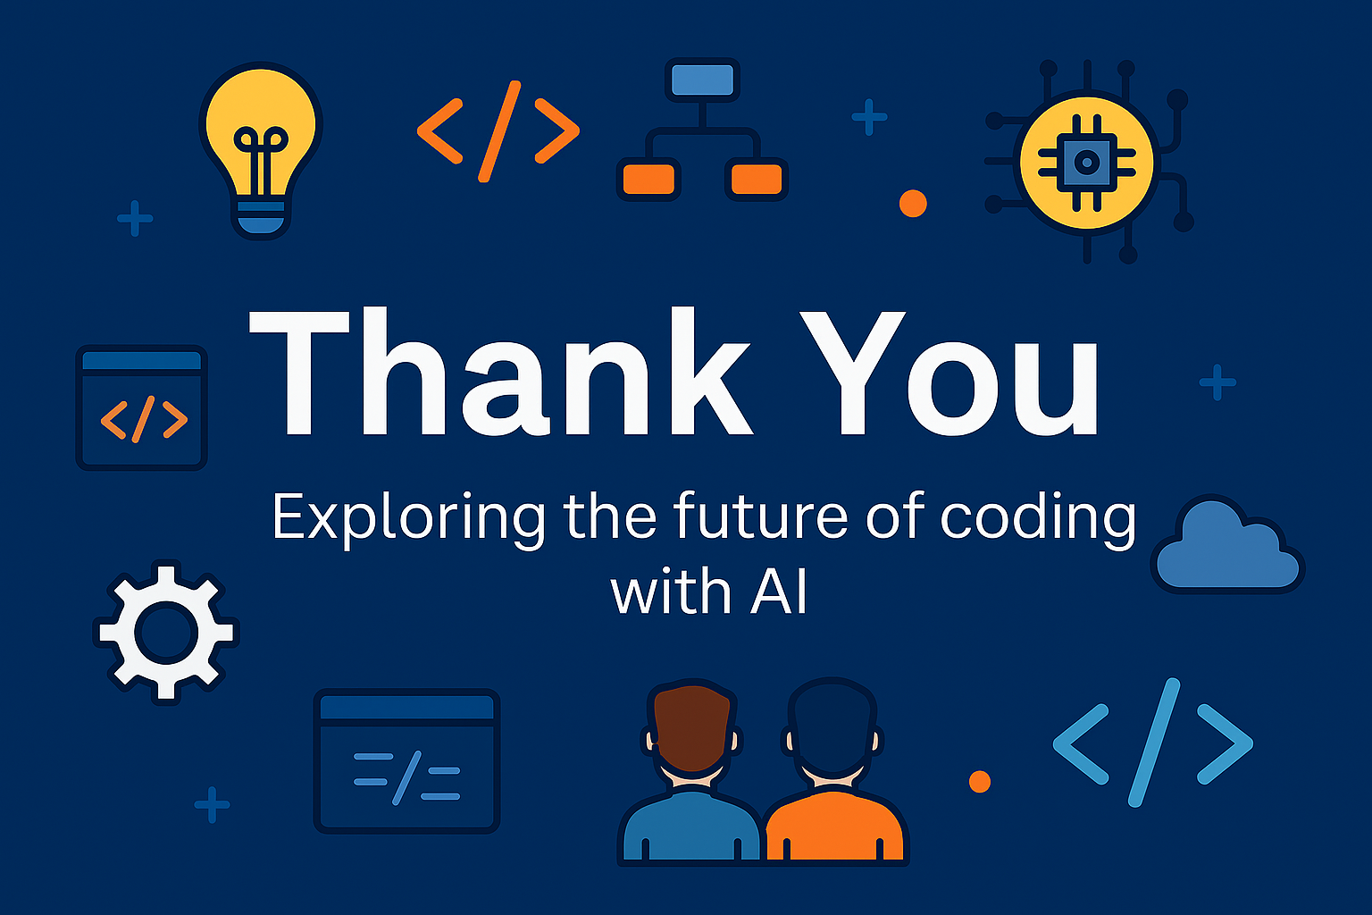
Ilona Pawełoszek
ilona.paweloszek@pcz.pl
Developers empowered,
not replaced… yet.
Notes:
So in short — developers are still here, empowered by AI, not replaced… yet.
Let’s see what happens after dinner.
Thank you!”

